Slide 1

Controlling Player Avatars and Game Worlds Using Multi-Modal Input Systems
Final Year Project: Viva
( Portfolio Project )
By:
Charlie Lloyd-Buckingham
( s5109920 )

Slide 2
Project Plan

Slide 3

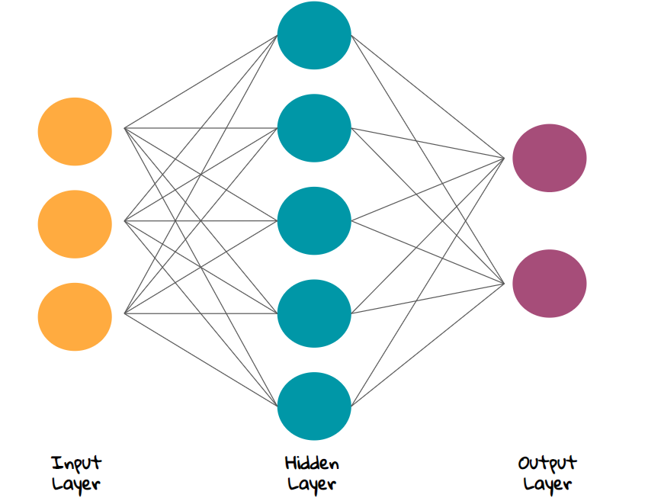

Original Project Plan:
EEG Input
EMG Input
Eye Tracking Input
To build a multi-modal input system / pipeline for supporting EEG, EMG and eye-tracking.
Data:
EEG data -EEGO amplifier
EMG data – emteqPro
Eye tracking from HTC Vive Pro
Data streams will be fed as inputs for a neural network for processing.
Output will be used for two game inputs
( Mood -> Difficulty ) calculator for simple game.
Avatar rig controller

Slide 4
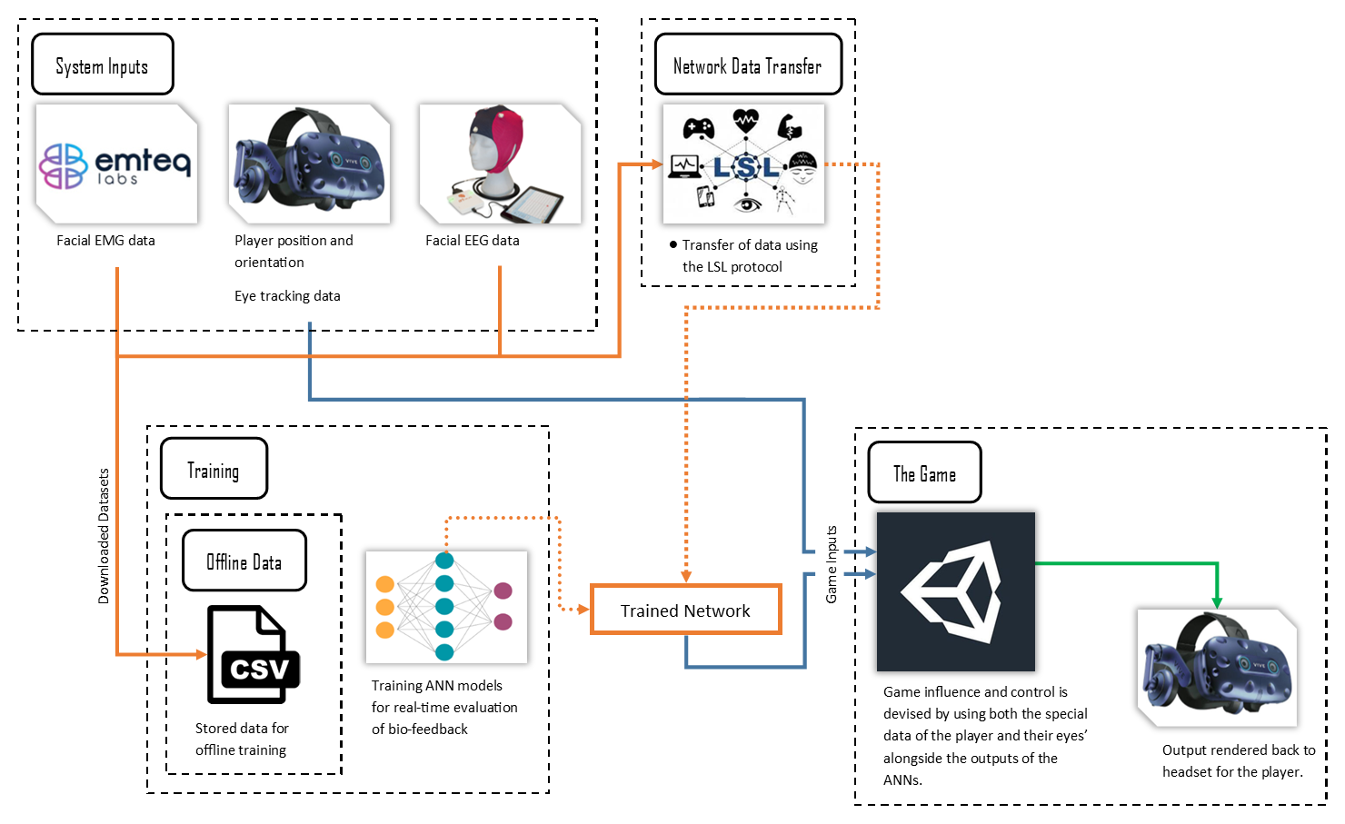
Final Project Plan:
To build a platform that supports the communication of input multiple devices and classification of EEG, EMG and other data.
The project was split into 4 sections:
Data Acquisition / System Inputs
Network Communication
Machine Learning
The test artifact

Slide 5
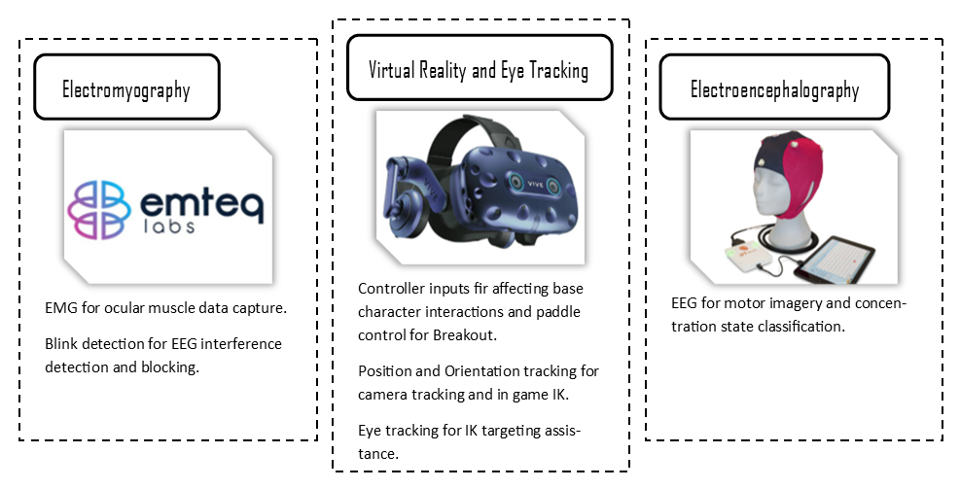
System Inputs:
Inputs within the project consisted of EEG, EMG and the typical inputs from either a VR headset or Windows PC.
Electromyography:
Blink detection for interference detection and blocking.
Electroencephalography:
Avatar arm control
Adaptive difficulty
Windows Input / VR:
Interacting within the game for generic inputs like menu’s and controlling parts of the mini-games.
Character orientation controls.

Slide 6
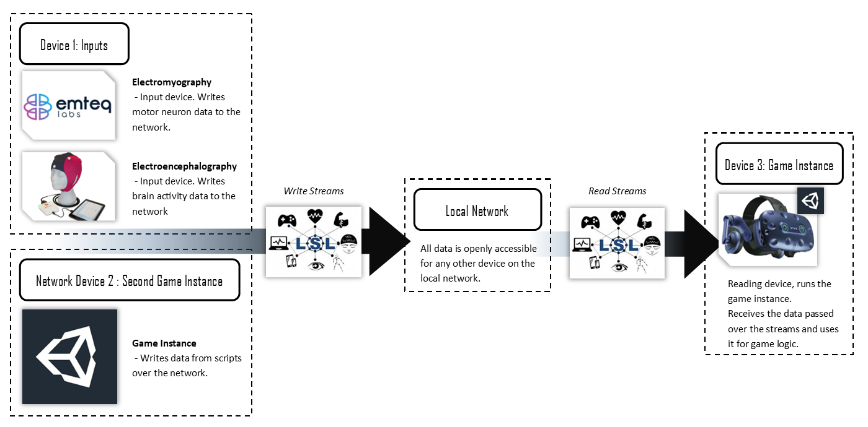
Local Network Communication:
Cross device communication using the LSL protocol.
LSL StreamOutlet used to broadcast streams to the entire local network.
LSL StreamInlet used to listen and pull samples from broadcasted streams.

Slide 7
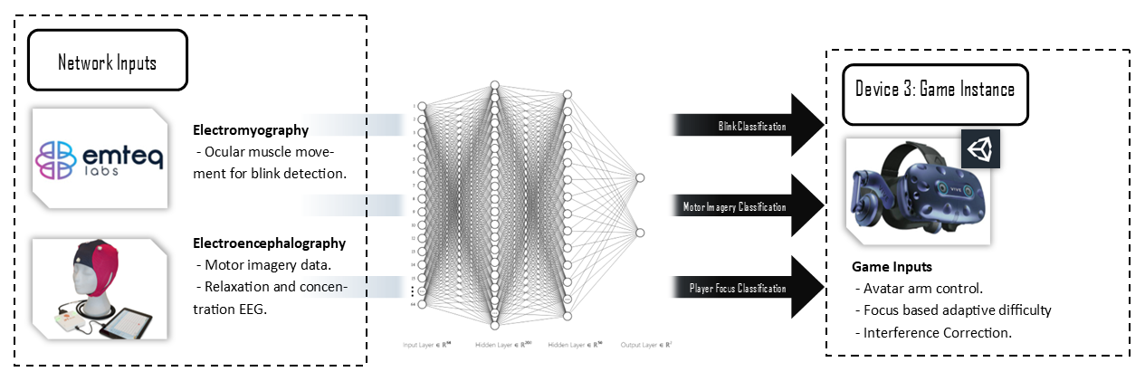
Machine Learning:
Feed Forward Neural Networks created with TensorFlow used to classify the EEG and EMG data.
Electromyography:
Blink detection classification
Electroencephalography:
Motor imagery classification
Relaxation to concentration classification.

Slide 8
Implementation

Slide 9
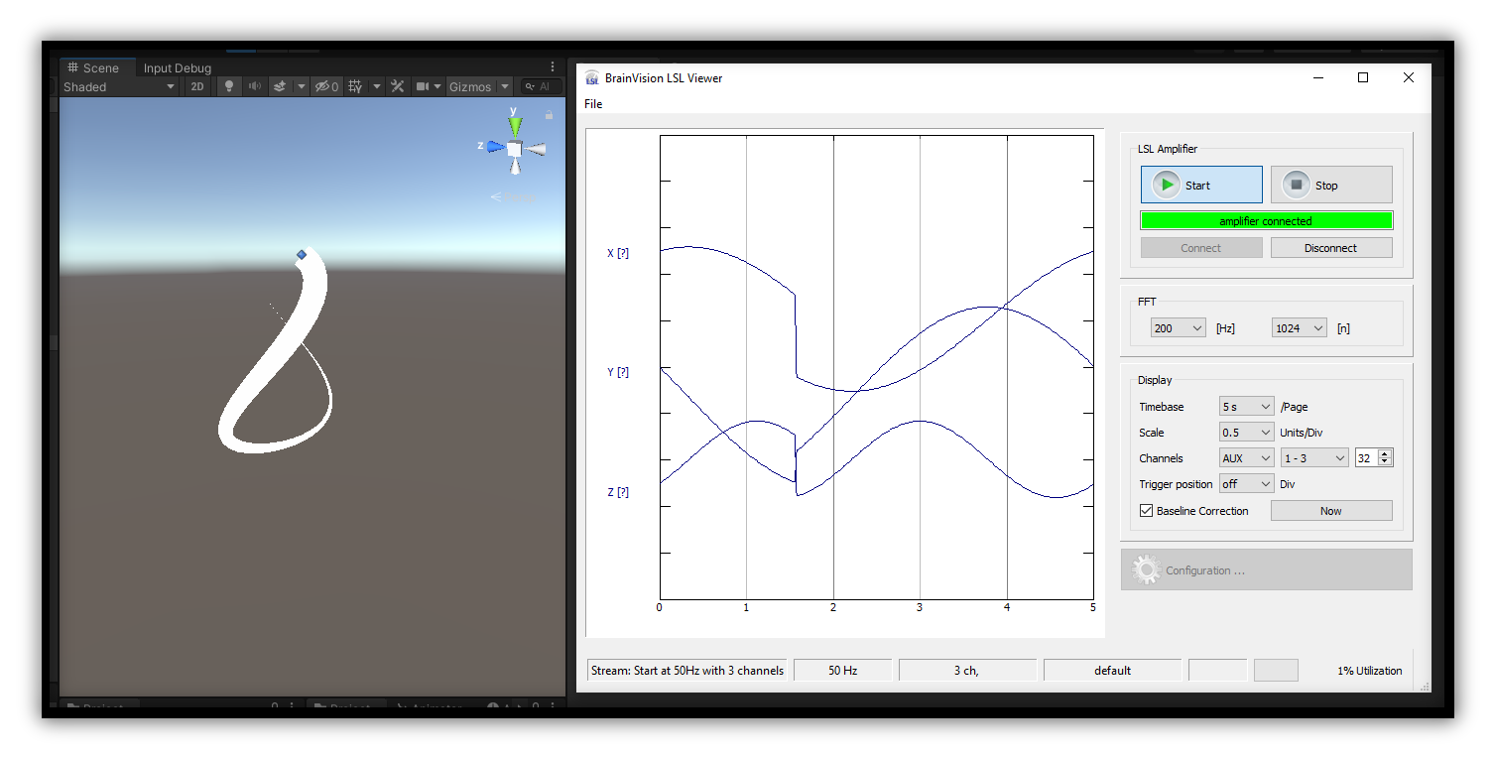
LSL Integration:
Data Spoofing
Due to the automatic transferring of LSL data from EEG devices no real work needs to be put into this. Instead for matching the channel size / data structure used with the training data spoofing of pre-recorded data was used.
LSLInput<T> Class
Abstract class I created to interface with the LSL C# class for Unity and read data from the network.
LSLOutput<T> Class
Abstract class I created to interface with the LSL C# class for Unity and read data from the network.

Slide 10
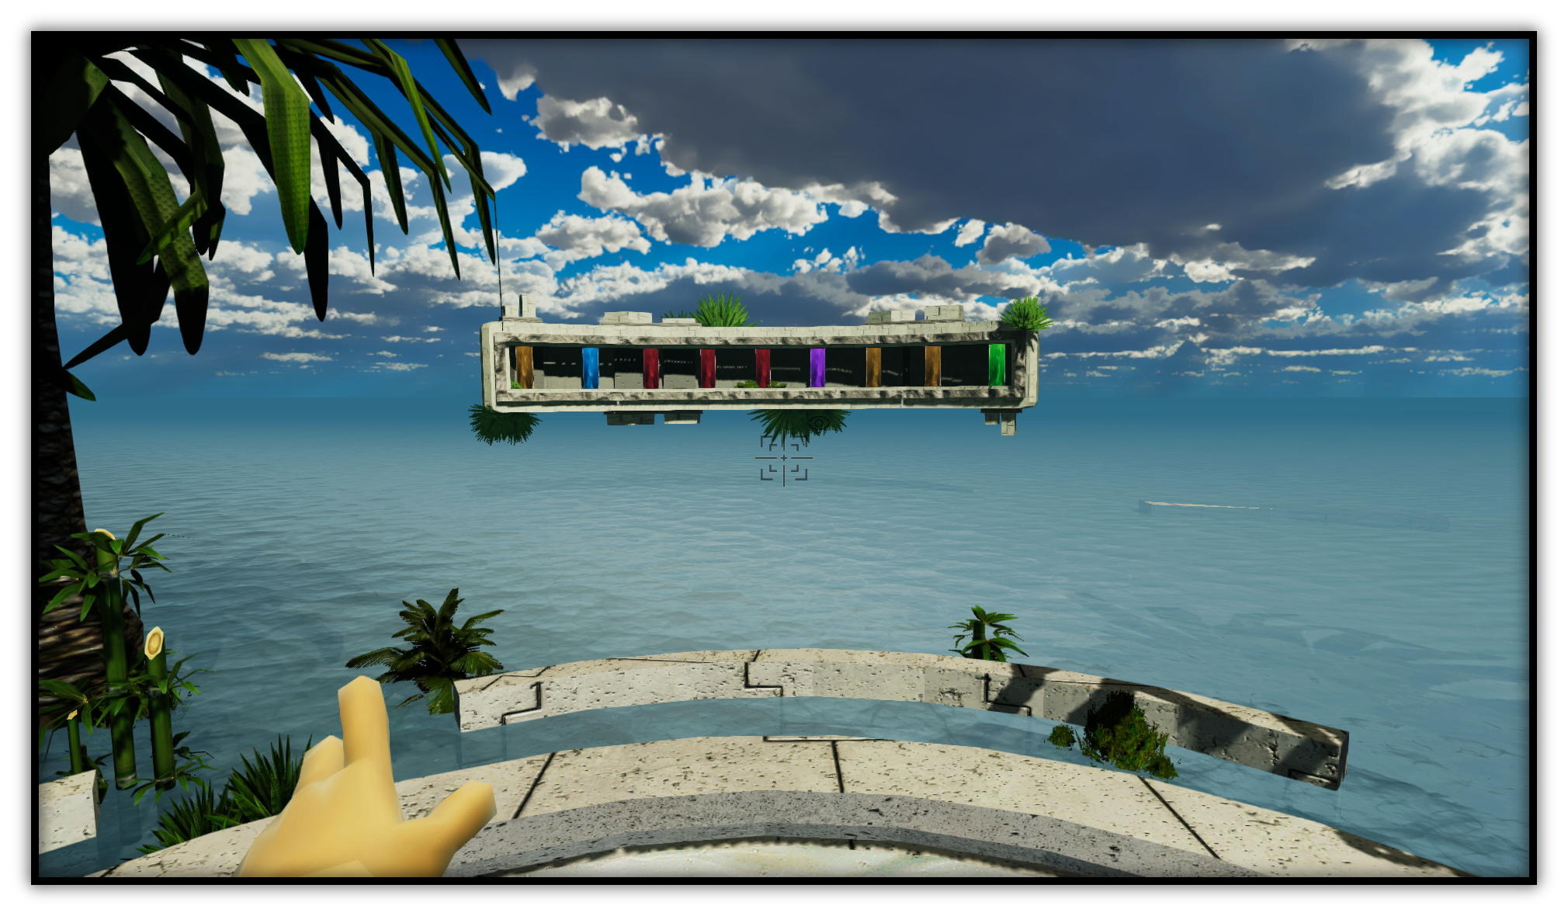
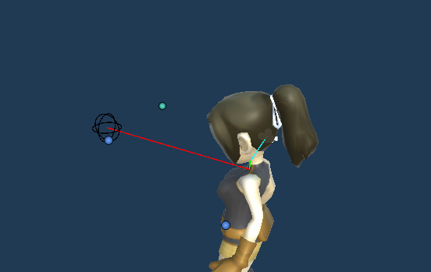
Avatar Control:
Arm Activation:
Mouse / VR Controller Input (XR Integration Toolkit)
Activation value changed via input binds from the XR Interaction Toolkits new input system.
EEG classification of motor imagery
Neural networks used to classify the EEG stream samples into a left, right or neural thought. This was then used to increment or decrement the activation value
Inverse Kinematics
Arm bones where controlled via a the Animation Rigging packages Two Bone IK constraint.

Slide 11
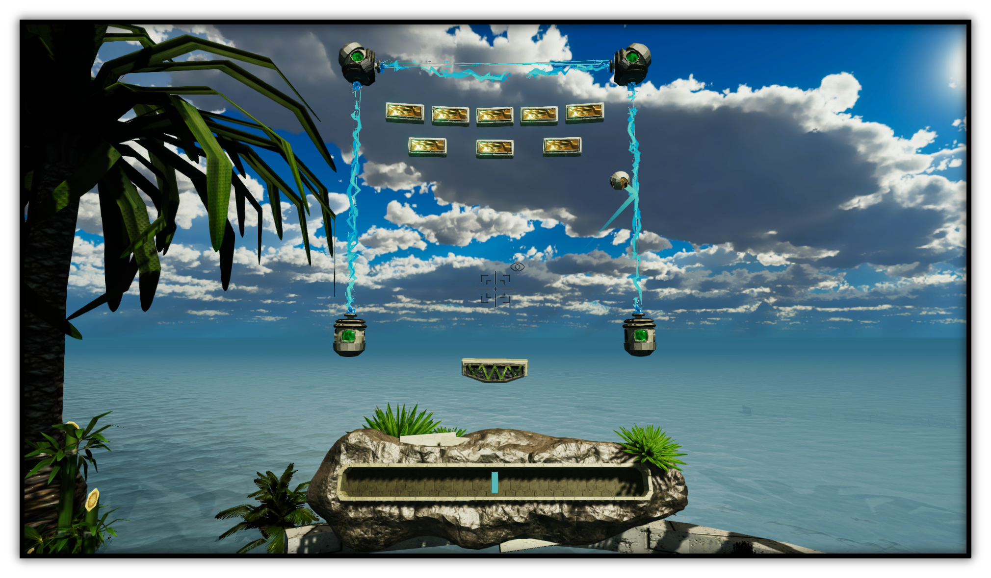
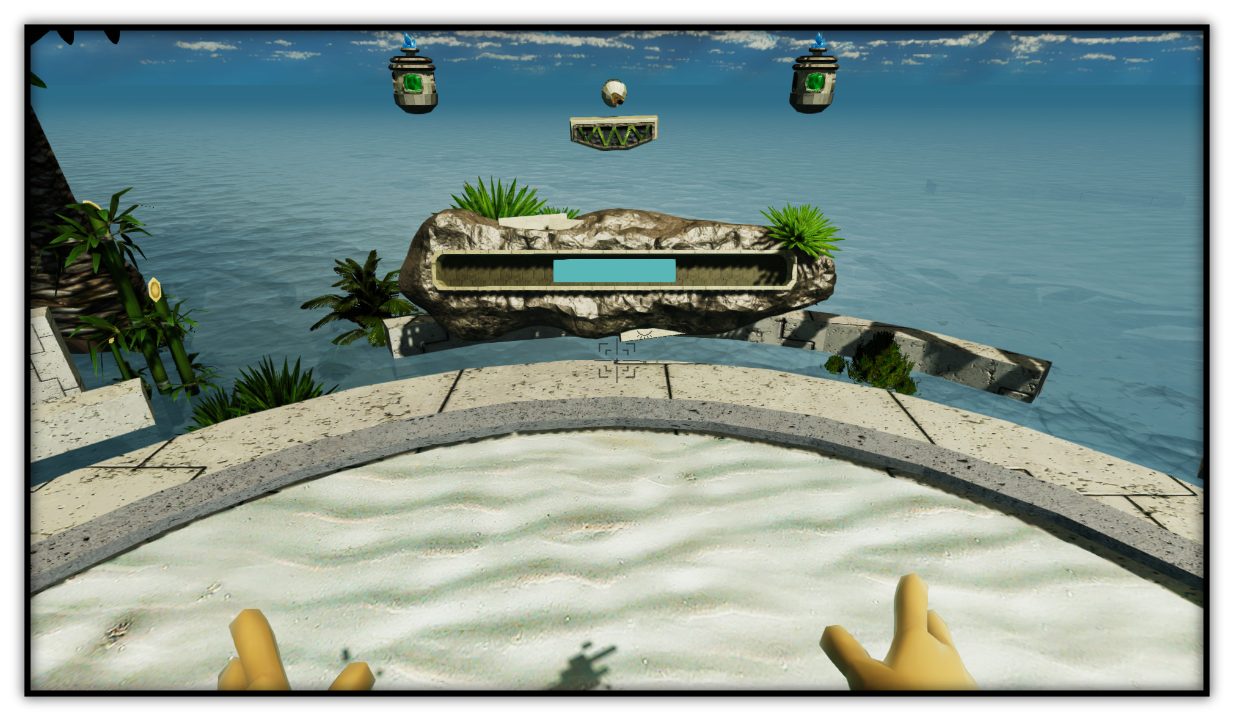
Adaptive Difficulty
Focus Activation variable
Ball Speed
Ball speed is the result of a linear interpolation between a max and min speed. The t-value of this lerp is the focus activation value.
EEG classification of concentration.
The change of focus activation was defined by the results of the concentration classification network.
Concentrated => Slow Relaxed => Fast
Visualised focus using the world space UI

Slide 12
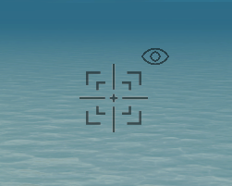
Interference Handling
Blink detection.
Blocking data samples
EMG neural network used to classify blink appearances.
Sampling of EEG for concentration classification and motor imagery classification blocked to avoid mis-sampling the data.
Visualised
Blinks shown via an indicator by the cross-hair.

Slide 13
Artefact Demo

Slide 14

https://youtu.be/79deKa6WMHg

Slide 15
Conclusions

Slide 16
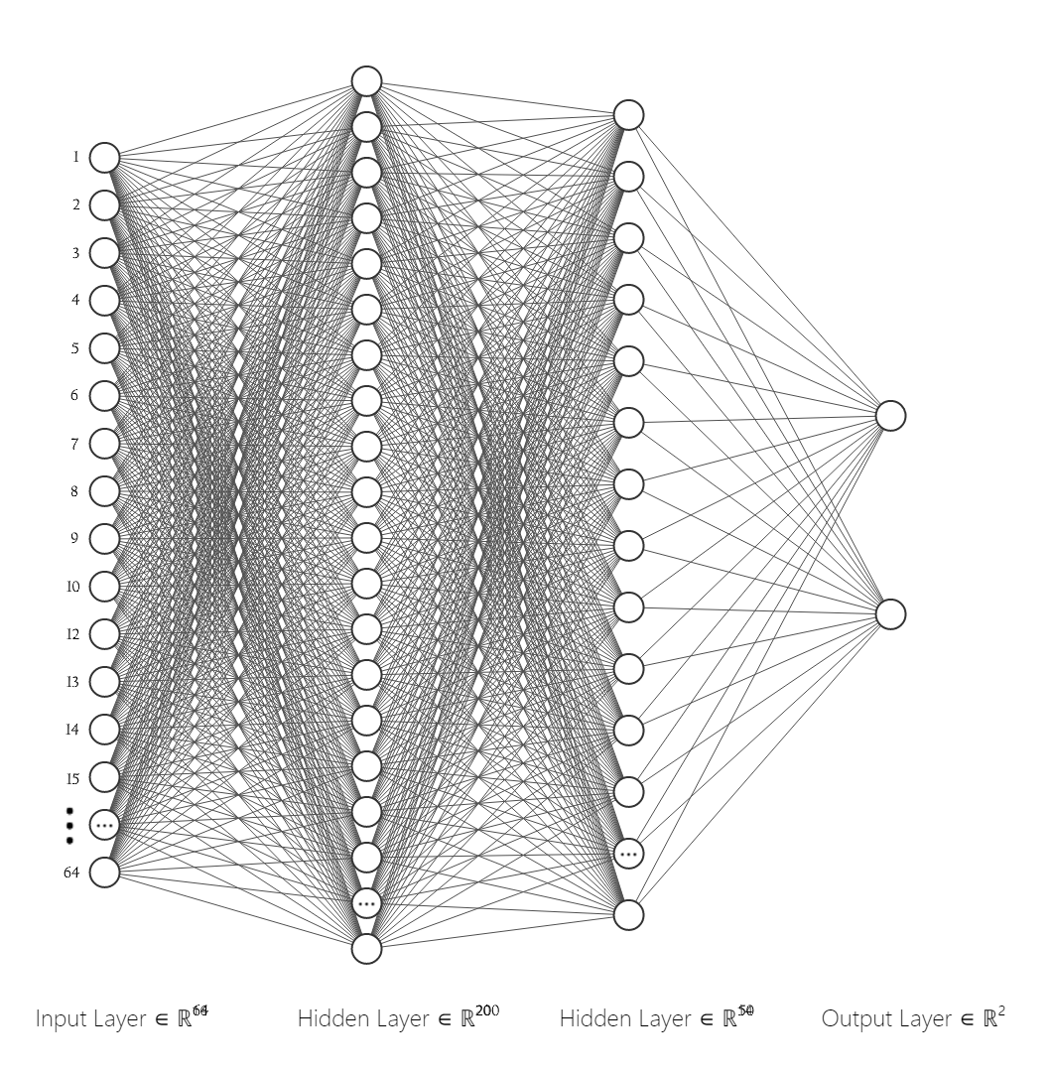
Interference Handling
Network Performance
EMG showed good detection for unseen data,
Sampling of EEG for concentration classification and motor imagery classification blocked to avoid mis-sampling the data.
Mini-game Usefulness
Adaptive difficulty could have been put to better use for a more unconscious classification, while also building up a more complex profile on the player rather then using something so simple.
The sequence game was built to let players try to move whichever hand was more comfortable towards a crystal, this might not have worked as intended however.

Slide 17
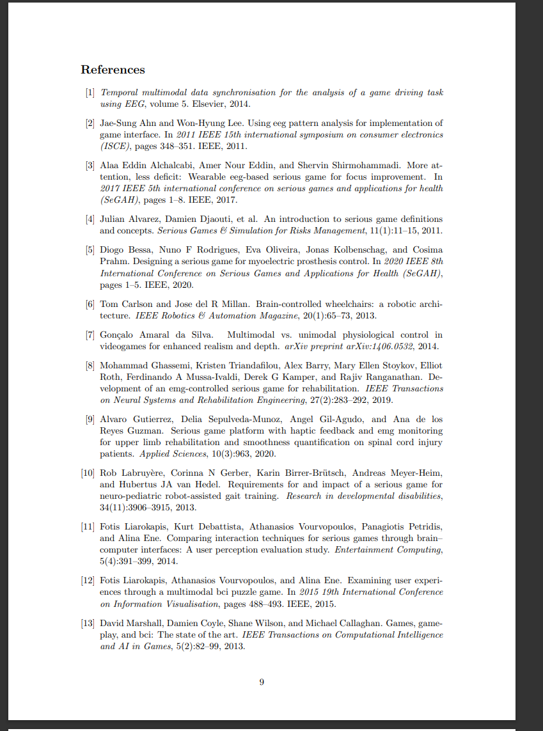
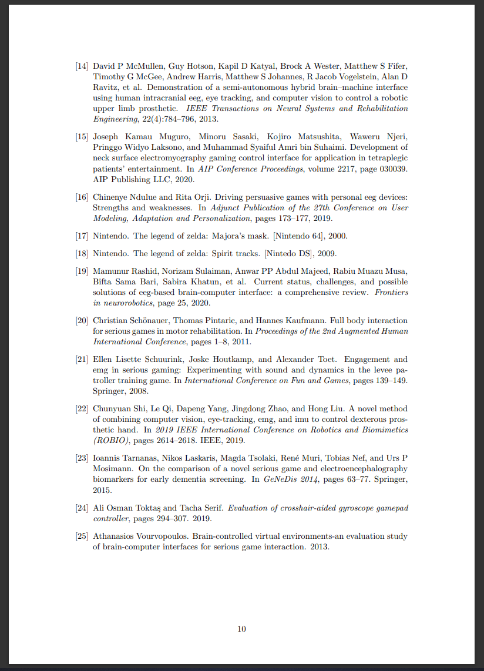
References:
Papers Used in Presentation
( Carlson, 2013 )
( McMullen, 2013 )
( Haris, 2021 )

